Slide 1


Predictive Analytics for Oil Well Failures: A Machine Learning Approach
Presented by:
Titilola Oduwole & Jahir Gutierrez
Date: June 2024
IT: Business and Advanced
Analytics

Slide 2
Table of Contents
01
02
03
04
Setting the Stage
Data and Methodology
Results and Analysis
Conclusions and Recommendations
Introduction and Motivation
Problem Statement and Significance
Data Overview
Methodology
ML model performance
Key Insights
Summary of findings

Slide 3
Introduction The Rationale Behind This Project.
KUSD 130
is the average cost per well to repair a downhole failure (excluding lost production).
The true cost of well failures impacts the environment, safety, and your bottom line.
Predictive Analytics for Oil Well Failures: A Machine Learning Approach | Titilola Oduwole and Jahir Gutierrez

Slide 4
Problem Statement
Output:
An actionable prediction ("Intervention Needed" or "No Intervention")
Input:
Operational data
(10 years).
To develop a Machine Learning Model to predict failures in oil wells
Approach:
Evaluate multiple algorithms, feature eng., and rigorous validation
Challenges:
Data: Imbalanced classes (few failures)
Modeling: Complex relationships
Predictive Analytics for Oil Well Failures: A Machine Learning Approach | Titilola Oduwole and Jahir Gutierrez

Slide 5
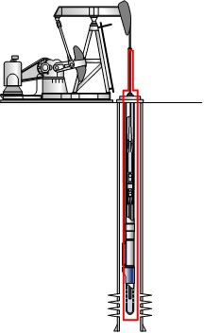
Business Understanding
INITIAL START
DATE
FINAL STOP
DATE
Installation
Date
Pulling
Date
Down Time
Down Time
Artificial Lift System
Fluid Level
Total fluid rate =
Water + Oil
Run Life = Final Stop Date – Initial Start Date
Pump intake
Well Intervention Type:
Failures and No Failures
BSW (%)
Chloride (ppm)
Predictive Analytics for Oil Well Failures: A Machine Learning Approach | Titilola Oduwole and Jahir Gutierrez

Slide 6
Project Objectives
Develop a robust Machine Learning model that predicts failures in oil wells before they occur.
Reduce oil well downtime related to producer oil well failures
Improve failure prediction accuracy to reduce economic impacts.
Reduce the economic impact of equipment failures and associated downtimes.
Predictive Analytics for Oil Well Failures: A Machine Learning Approach | Titilola Oduwole and Jahir Gutierrez

Slide 7




Data Preparation
Data Integration:
Information was record of 10 years:
Production
Laboratories
Fluid level
Failures
Data Cleaning and Transformation:
Anonymization techniques employ hashing
Missing values
Outliers handling using IQR.
Inconsistencies
Language differences
Data Preprocessing:
Creation of new features like "BSW (%)“, and “Total fluid rate”.
Encoding Categorical Variables such as “Artificial Lift Systems”
Well Intervention Type selected as the target variable
ML Well Failures Prediction
Database for Modeling
Predictive Analytics for Oil Well Failures: A Machine Learning Approach | Titilola Oduwole and Jahir Gutierrez

Slide 8
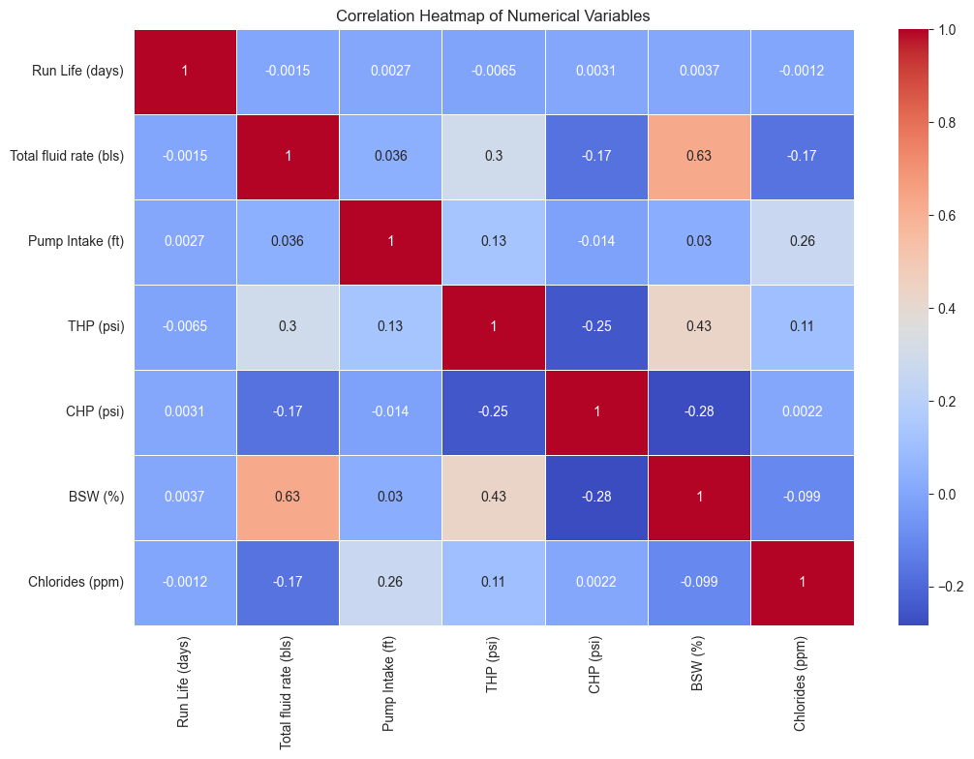
Matrix Correlation
Strong positive correlation between total fluid rate and BSW.
Weak correlation between run life and other variables.
Inverse relationship: THP and CHP.
Predictive Analytics for Oil Well Failures: A Machine Learning Approach | Titilola Oduwole and Jahir Gutierrez

Slide 9
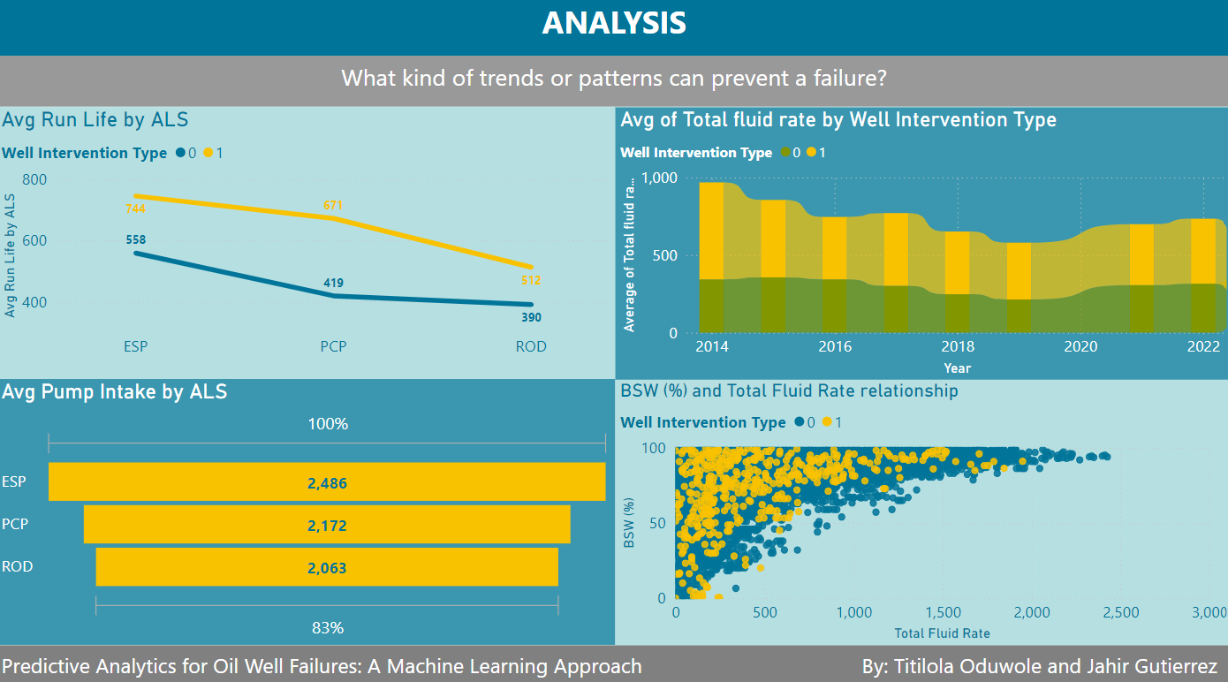

Slide 10





Modeling
Split into train and test sets using StratifiedShuffleSplit
Train and test sets (70 / 30)
Train and validation sets (80 / 20)
SMOTE for “oversampling” the class distribution:
Before:
0: 714,142 vs 1: 87,653
After:
1,428,284
Data Balancing
Data Splitting
Model Algorithms
Feature Selection
Models Evaluation
ML Model algorithms selection
Using SelectKBest
RFE:
Total fluid rate
Fluid Level
BSW
Chlorides
Run Life
PCA with 95 of variance.
XGBoost
Decision Tree
Logistic Regression
Performance metrics:
Accuracy
Precision
Recall:
F1 Score
Predictive Analytics for Oil Well Failures: A Machine Learning Approach | Titilola Oduwole and Jahir Gutierrez

Slide 11
Modeling
XGBoost Model achieved the highest accuracy. It has been validated as recommended for primary use due to its reliability in predicting oil well failures.
Precision: 95.56 %
F1 Score: 95.41 %
Recall: 95.27 %
Predictive Analytics for Oil Well Failures: A Machine Learning Approach | Titilola Oduwole and Jahir Gutierrez
Notes:
Good balance between accuracy and interpretability. Useful for scenarios where understanding underlying factors is crucial.

Slide 12
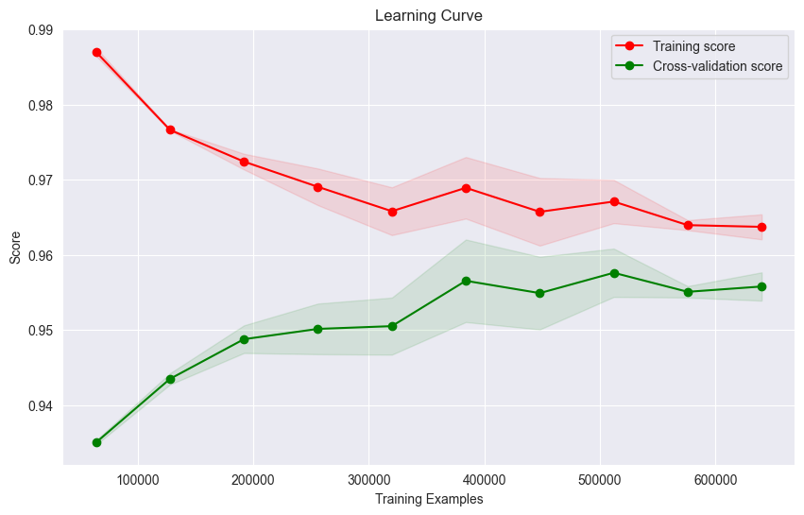
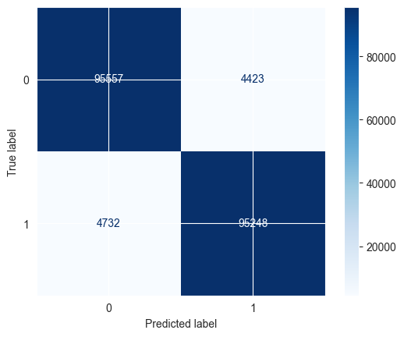
Modeling Results - XGBoost
XGBoos Model demonstrates a good fit with increasing accuracy as the training data grows.
CM indicates that the model performs well overall, with a balanced number of true positives and true negatives
Predictive Analytics for Oil Well Failures: A Machine Learning Approach | Titilola Oduwole and Jahir Gutierrez

Slide 13

Conclusions and Recommendations
The XGBoost model achieved the highest accuracy (95.42%).
Perform a different Analysis Artificial Lift System (with and no rod strings) and Run Life.
Perform a future analysis including the impact of water injection on well production performance.
The Decision Tree model (accuracy of 94.45%) shows a balance between accuracy and interpretability.

Slide 14
References
Predictive Analytics for Oil Well Failures: A Machine Learning Approach
Pennel, M., Hsiung, J., & Putcha, V. B. (2018). Detecting failures and optimizing performance in artificial lift using machine learning models. SPE Western Regional Meeting, Garden Grove, California, USA, 22-27 April 2018. Society of Petroleum Engineers. SPE-190090-MS.
Reddicharla, N., Ali Sultan Ali, M., Alshehhi, S. S., Elmansour, A., & ReddyVanam, P. (2023). ESP failure prediction in water supply wells using unsupervised learning. Gas & Oil Technology Showcase and Conference, Dubai, UAE, 13-15 March 2023. Society of Petroleum Engineers. SPE-214010-MS.

Slide 15
References
Pandey, Y. N., Rastogi, A., Kainkaryam, S., Bhattacharya, S., & Saputelli, L. (2020). Machine learning in the oil and gas industry: Including geosciences, reservoir engineering, and production engineering with Python (Chapter 7). Apress.
Belyadi, H., & Haghighat, A. (2021). Machine Learning Guide for Oil and Gas Using Python (Chapters 4 and 5). Gulf Professional Publishing.
Holdaway, K. (2014). Optimize Exploration and Production with Data Driven Models (Chapter 8). John Wiley & Sons, Inc.
Bangert, P. (2021). In Machine Learning and Data Science in the Oil and Gas Industry (Chapters 11 and 12). Gulf Professional Publishing.

Slide 16

Questions?

